Slide 1

Theories of Light
MD. GULAM MUSTAFA
Lecturer (Physics)
Department of Science & Humanities
Bangladesh Army International University of Science and Technology (BAIUST)
Syedpur, Cumilla-3501

Slide 2

Whatever we will discuss
Corpuscular Theory or Emission Theory
Wave Theory
Electromagnetic Theory
Quantum Theory

Slide 3
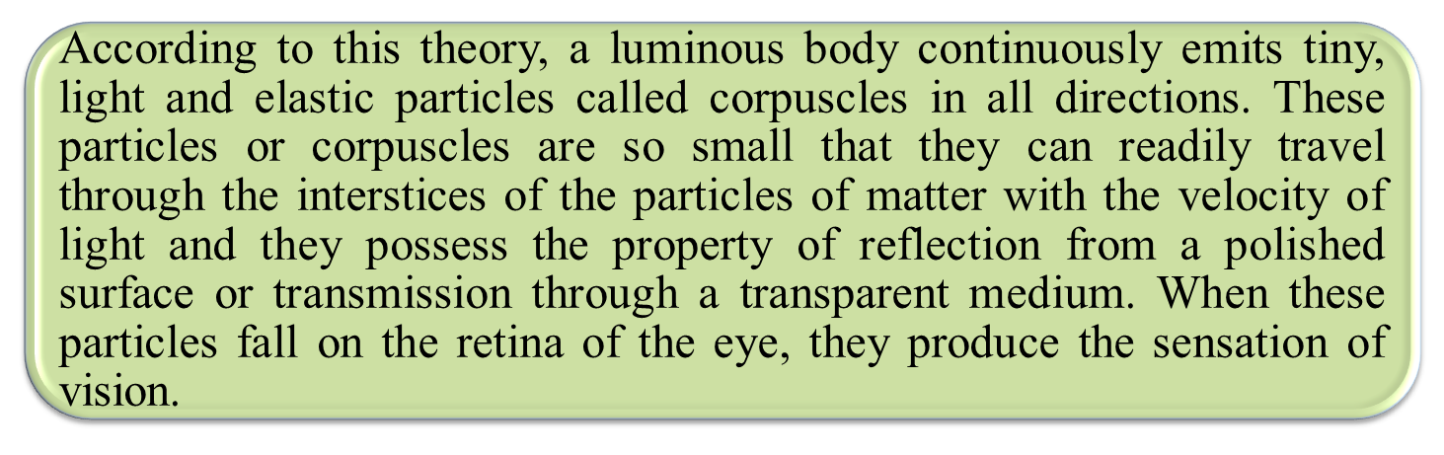
Corpuscular Theory
1672_Sir Isaac Newton
Can Explain: Reflection, Refraction
Can’t Explain: Interference, Diffraction, Polarization, Photo Electric Effect

Slide 4
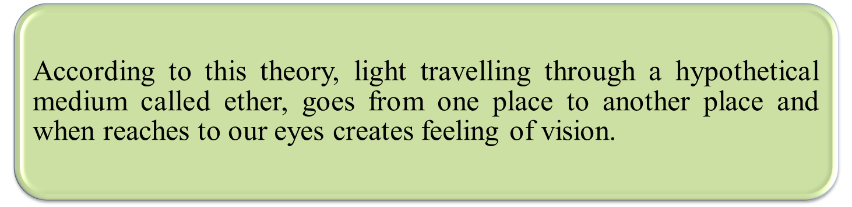
Wave Theory
1678_Huygens
Can Explain: Reflection, Refraction, Interference, Diffraction
Can’t Explain: Polarization, Photo Electric Effect

Slide 5
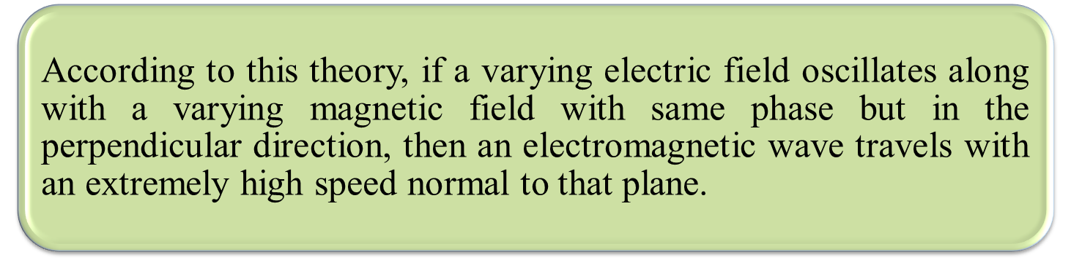
Electromagnetic Theory
1864_Maxwell
Can Explain: Polarization
Can’t Explain: Photo Electric Effect

Slide 6
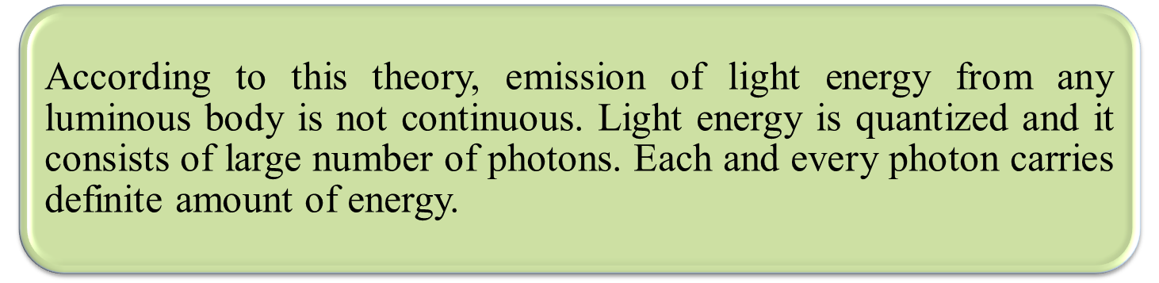
Quantum Theory
1900_Max Plank
Can Explain: Photo Electric Effect

Slide 7


